Slide 1

Entity Framework
3 – Coding Data Operations

Slide 2
Overview
Logging
Table-based CRUD Operations
Native queries and mapping to objects
Transactions
Relationships and Lazy Loading
Paging
Async

Slide 3
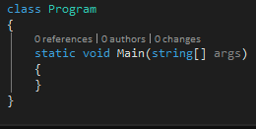
Create a Runner
Console application

Slide 4
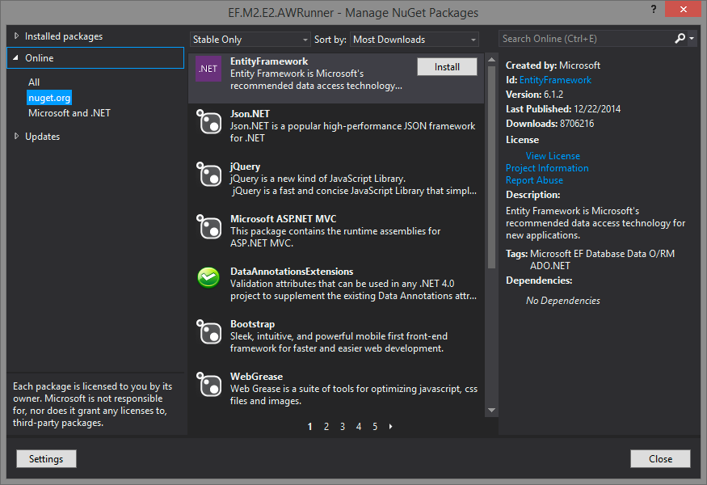
Reference EF

Slide 5
Logging
The Context Database.Log property
To the console or textwriter
DatabaseLogFormatter
Set it in a derivation of DbConfiguration
To Nlog with interception
IDbCommandInterceptor
https://msdn.microsoft.com/en-us/data/dn469464.aspx

Slide 6
Reading Data
Revolves around LINQ
Through the DbContext
All Data with .ToList()
All the operations you expect (where, orderby, …)
Find(id) returns single item or null
SingleOrDefault()
Objects are proxies if LazyLoading enable (it is by default)

Slide 7
Demo
Basic LINQ, finding objects
Ex 1-5

Slide 8
.Local
Access just data in the context
Also supports .CollectionChanged

Slide 9
Lazy Loading
Ctx.Configuration.LazyLoadingEnabled
True by default
POCO must be public and not sealed
Navigation properties must be virtual
Takes advantage of SQL Server Multiple Active Result Sets (MARS)

Slide 10
Eager Loading
.Include() in the query
Forces a join
Multiple can be included in one statement

Slide 11
Explicit Loading
Like lazy, but you have to specify the load
Why?
Don’t have to mark things as virtual
Existing class library that is not marked virtual
You are in complete control
How?
DbContext.Entry method

Slide 12
Checking if a Navigation Property is Loaded
.Collection().IsLoaded

Slide 13
Querying contents of a Collection Navigation Property
LINQ based query will bring back all data
Using a Entry.Collection will push it to the server

Slide 14
Demo
Various load operations

Slide 15
Table based CRUD
Get entities in a table
Add entities
Delete entities
Update

Slide 16
Note
EF Completely tracks state changes to all objects

Slide 17
Adding a new entity
Add it to the appropriate property of the context
DbContext.[Property].Add(object)
Then
DbContext.SaveChanges()
Different from Nhibernate
EF collects all object changes until you save SaveChanges and then does them in bulk

Slide 18
Updating an Entity
Simply change a property and call SaveChanges on the context
EF tracks all entity property changes ☺

Slide 19
Deleting an Entity
.Remove on the collection, then .SaveChanges()

Slide 20
Delete without Load
Use a stub object
.Attach the stub to the collection
Then .Remove it
Note:
Can’t attach an object already in memory

Slide 21
Delete with relationships
What happens depends on the relationship
Optional, child will not be deleted (Reservation in our example can exist without a Trip).
Required, child will be deleted (Lodging cannot exist without a Destination)
Deleting a parent of an optional, then the relationship will be deleted
Null pointers back to the parent in the FK

Slide 22
Change Tracking
DbContext has a ChangeTracker property
Each object is tracked, and change state can be found with DbContext.Entry(object).State

Slide 23
Change Tracking
Object will support IEntityWithChangeTracker
This is a proxy
Objects from queries are proxies
If an object creates other objects in a constructor, they will not be proxies if the parent is
Fix using DbSet.Create()
You can fetch without tracking using .AsNoTracking()
Can give better performance if you don’t need it

Slide 24
Summary
We’ve looked at the various ways of adding, updating and deleting objects and objects in relationships.
We also looked at change tracking through the proxies.

Slide 25
Demo

